Slide 1
Process Management in OS

Slide 2
Process Management in OS
A Program does nothing unless its instructions are executed by a CPU. A program in execution is called a process. In order to accomplish its task, process needs the computer resources.
There may exist more than one process in the system which may require the same resource at the same time. Therefore, the operating system has to manage all the processes and resources conveniently and efficiently.
Some resources may need to be executed by one process at a time to maintain consistency otherwise the system can become inconsistent and deadlock may occur.

Slide 3
Activities in connection with process management
Scheduling processes and threads on the CPUs.
Creating and deleting both user and system processes.
Suspending and resuming processes.
Providing mechanisms for process synchronization.
Providing mechanisms for process communication.

Slide 4
Attributes of a process
1. Process ID
When a process is created, a unique id is assigned to the process which is used for unique identification of the process in the system.
2. Program counter
A program counter stores the address of the last instruction of the process on which the process was suspended. The CPU uses this address when the execution of this process is resumed.

Slide 5
Attributes of a process
3. Process State
The Process, from its creation to the completion, goes through various states which are new, ready, running and waiting. We will discuss about them later in detail.
4. Priority
Every process has its own priority. The process with the highest priority among the processes gets the CPU first. This is also stored on the process control block.
5. General Purpose Registers
Every process has its own set of registers which are used to hold the data which is generated during the execution of the process.

Slide 6
Attributes of a process
6. List of open files
During the Execution, Every process uses some files which need to be present in the main memory. OS also maintains a list of open files in the PCB.
7. List of open devices
OS also maintain the list of all open devices which are used during the execution of the process.

Slide 7
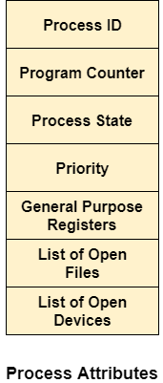
Attributes of a process

Slide 8
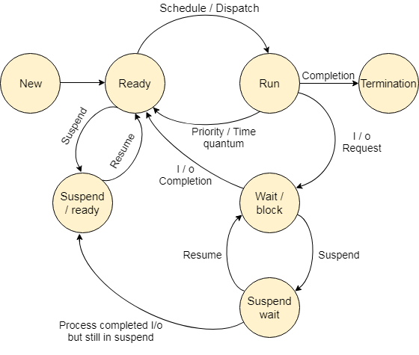
Process States
State Diagram
The process, from its creation to completion, passes through various states. The minimum number of states is five.

Slide 9
Process States
1. New
A program which is going to be picked up by the OS into the main memory is called a new process.
2. Ready
Whenever a process is created, it directly enters in the ready state, in which, it waits for the CPU to be assigned. The OS picks the new processes from the secondary memory and put all of them in the main memory.
The processes which are ready for the execution and reside in the main memory are called ready state processes. There can be many processes present in the ready state.
The names of the states are not standardized although the process may be in one of the following states during execution.

Slide 10
Process States
3. Running
One of the processes from the ready state will be chosen by the OS depending upon the scheduling algorithm. Hence, if we have only one CPU in our system, the number of running processes for a particular time will always be one. If we have n processors in the system then we can have n processes running simultaneously.
4. Block or wait
From the Running state, a process can make the transition to the block or wait state depending upon the scheduling algorithm or the intrinsic behavior of the process.
When a process waits for a certain resource to be assigned or for the input from the user then the OS move this process to the block or wait state and assigns the CPU to the other processes.

Slide 11
Process States
5. Completion or termination
When a process finishes its execution, it comes in the termination state. All the context of the process (Process Control Block) will also be deleted the process will be terminated by the Operating system.
6. Suspend ready
A process in the ready state, which is moved to secondary memory from the main memory due to lack of the resources (mainly primary memory) is called in the suspend ready state.
If the main memory is full and a higher-priority process comes for execution then the OS have to make the room for the process in the main memory by throwing the lower priority process out into the secondary memory. The suspend ready processes remain in the secondary memory until the main memory gets available.
7. Suspend wait
Instead of removing the process from the ready queue, it's better to remove the blocked process which is waiting for some resources in the main memory. Since it is already waiting for some resource to get available hence it is better if it waits in the secondary memory and make room for the higher priority process. These processes complete their execution once the main memory gets available and their wait is finished.

Slide 12
Operations on the Process
1. Creation
Once the process is created, it will be ready and come into the ready queue (main memory) and will be ready for the execution.
2. Scheduling
Out of the many processes present in the ready queue, the Operating system chooses one process and start executing it. Selecting the process which is to be executed next, is known as scheduling.
3. Execution
Once the process is scheduled for the execution, the processor starts executing it. Process may come to the blocked or wait state during the execution then in that case the processor starts executing the other processes.

Slide 13
Operations on the Process
4. Deletion/killing
Once the purpose of the process gets over then the OS will kill the process. The Context of the process (PCB) will be deleted and the process gets terminated by the Operating system.

Slide 14
Process Scheduling in OS (Operating System)
1. Long term scheduler
Long term scheduler is also known as job scheduler. It chooses the processes from the pool (secondary memory) and keeps them in the ready queue maintained in the primary memory.
Long Term scheduler mainly controls the degree of Multiprogramming. The purpose of long term scheduler is to choose a perfect mix of IO bound and CPU bound processes among the jobs present in the pool.
If the job scheduler chooses more IO bound processes then all of the jobs may reside in the blocked state all the time and the CPU will remain idle most of the time. This will reduce the degree of Multiprogramming. Therefore, the Job of long term scheduler is very critical and may affect the system for a very long time.

Slide 15
Process Scheduling in OS (Operating System)
2. Short term scheduler
Short term scheduler is also known as CPU scheduler. It selects one of the Jobs from the ready queue and dispatch to the CPU for the execution.
A scheduling algorithm is used to select which job is going to be dispatched for the execution. The Job of the short term scheduler can be very critical in the sense that if it selects job whose CPU burst time is very high then all the jobs after that, will have to wait in the ready queue for a very long time.
This problem is called starvation which may arise if the short term scheduler makes some mistakes while selecting the job.

Slide 16
Process Scheduling in OS (Operating System)
3. Medium term scheduler
Medium term scheduler takes care of the swapped out processes.If the running state processes needs some IO time for the completion then there is a need to change its state from running to waiting.
Medium term scheduler is used for this purpose. It removes the process from the running state to make room for the other processes. Such processes are the swapped out processes and this procedure is called swapping. The medium term scheduler is responsible for suspending and resuming the processes.
It reduces the degree of multiprogramming. The swapping is necessary to have a perfect mix of processes in the ready queue.

Slide 17
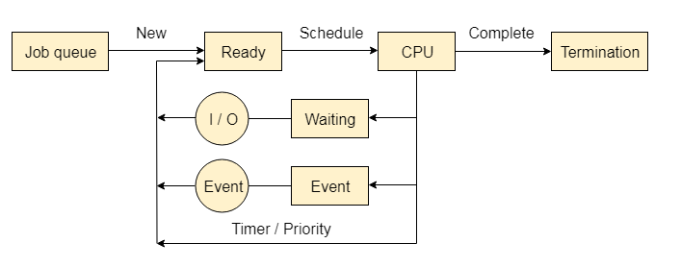
Process Queues
The Operating system manages various types of queues for each of the process states. The PCB related to the process is also stored in the queue of the same state. If the Process is moved from one state to another state then its PCB is also unlinked from the corresponding queue and added to the other state queue in which the transition is made.

Slide 18
Process Queues
1. Job Queue
In starting, all the processes get stored in the job queue. It is maintained in the secondary memory. The long-term scheduler (Job scheduler) picks some of the jobs and puts them in the primary memory.
2. Ready Queue
Ready queue is maintained in primary memory. The short-term scheduler picks the job from the ready queue and dispatches to the CPU for the execution.
3. Waiting Queue
When the process needs some IO operation in order to complete its execution, OS changes the state of the process from running to waiting. The context (PCB) associated with the process gets stored on the waiting queue which will be used by the Processor when the process finishes the IO.

Slide 19
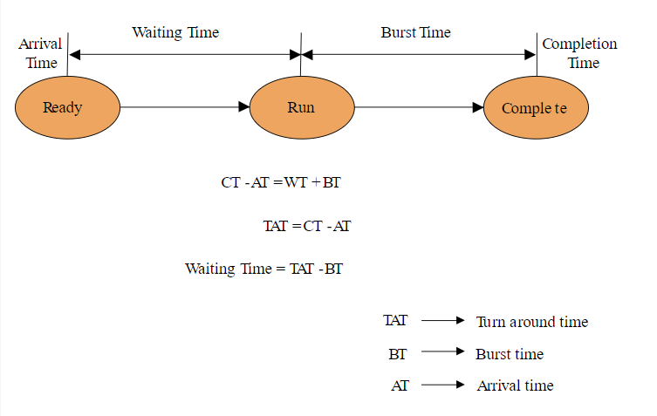
Various Times related to the Process

Slide 20
Various Times related to the Process
1. Arrival Time
The time at which the process enters into the ready queue is called the arrival time.
2. Burst Time
The total amount of time required by the CPU to execute the whole process is called the Burst Time. This does not include the waiting time. It is confusing to calculate the execution time for a process even before executing it hence the scheduling problems based on the burst time cannot be implemented in reality.
3. Completion Time
The Time at which the process enters into the completion state or the time at which the process completes its execution, is called completion time.
4. Turnaround time
The total amount of time spent by the process from its arrival to its completion, is called Turnaround time.

Slide 21
Various Times related to the Process
5. Waiting Time
The Total amount of time for which the process waits for the CPU to be assigned is called waiting time.
6. Response Time
The difference between the arrival time and the time at which the process first gets the CPU is called Response Time.

Slide 22
Memory Management in Operating System
The term memory can be defined as a collection of data in a specific format. It is used to store instructions and process data. The memory comprises a large array or group of words or bytes, each with its own location. The primary purpose of a computer system is to execute programs. These programs, along with the information they access, should be in the main memory during execution. The CPU fetches instructions from memory according to the value of the program counter.
To achieve a degree of multiprogramming and proper utilization of memory, memory management is important. Many memory management methods exist, reflecting various approaches, and the effectiveness of each algorithm depends on the situation.

Slide 23
What is Main Memory?
The main memory is central to the operation of a Modern Computer. Main Memory is a large array of words or bytes, ranging in size from hundreds of thousands to billions. Main memory is a repository of rapidly available information shared by the CPU and I/O devices. Main memory is the place where programs and information are kept when the processor is effectively utilizing them. Main memory is associated with the processor, so moving instructions and information into and out of the processor is extremely fast. Main memory is also known as RAM (Random Access Memory). This memory is volatile. RAM loses its data when a power interruption occurs.

Slide 24
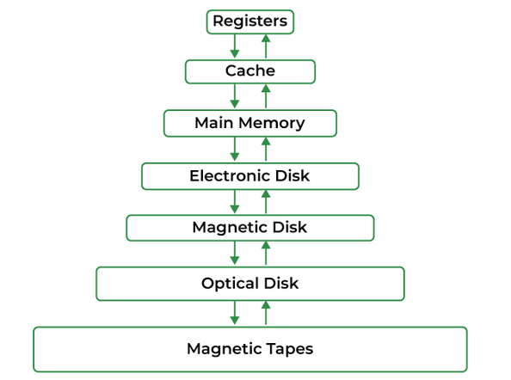
What is Main Memory?

Slide 25
Why Memory Management is Required?
Allocate and de-allocate memory before and after process execution.
To keep track of used memory space by processes.
To minimize fragmentation issues.
To proper utilization of main memory.
To maintain data integrity while executing of process.

Slide 26
Logical and Physical Address Space
Logical Address Space: An address generated by the CPU is known as a “Logical Address”. It is also known as a Virtual address. Logical address space can be defined as the size of the process. A logical address can be changed.
Physical Address Space: An address seen by the memory unit (i.e. the one loaded into the memory address register of the memory) is commonly known as a “Physical Address”. A Physical address is also known as a Real address. The set of all physical addresses corresponding to these logical addresses is known as Physical address space. A physical address is computed by MMU. The run-time mapping from virtual to physical addresses is done by a hardware device Memory Management Unit(MMU). The physical address always remains constant.

Slide 27
Static and Dynamic Loading
Static Loading: Static Loading is loading the entire program into a fixed address. It requires more memory space.
Dynamic Loading: The entire program and all data of a process must be in physical memory for the process to execute. So, the size of a process is limited to the size of physical memory. To gain proper memory utilization, dynamic loading is used. In dynamic loading, a routine is not loaded until it is called. All routines are residing on disk in a relocatable load format. One of the advantages of dynamic loading is that the unused routine is never loaded. This loading is useful when a large amount of code is needed to handle it efficiently.

Slide 28
Static and Dynamic Linking
To perform a linking task a linker is used. A linker is a program that takes one or more object files generated by a compiler and combines them into a single executable file.
Static Linking: In static linking, the linker combines all necessary program modules into a single executable program. So there is no runtime dependency. Some operating systems support only static linking, in which system language libraries are treated like any other object module.
Dynamic Linking: The basic concept of dynamic linking is similar to dynamic loading. In dynamic linking, “Stub” is included for each appropriate library routine reference. A stub is a small piece of code. When the stub is executed, it checks whether the needed routine is already in memory or not. If not available then the program loads the routine into memory.

Slide 29
Swapping
When a process is executed it must have resided in memory. Swapping is a process of swapping a process temporarily into a secondary memory from the main memory, which is fast compared to secondary memory. A swapping allows more processes to be run and can be fit into memory at one time. The main part of swapping is transferred time and the total time is directly proportional to the amount of memory swapped. Swapping is also known as roll-out, or roll because if a higher priority process arrives and wants service, the memory manager can swap out the lower priority process and then load and execute the higher priority process. After finishing higher priority work, the lower priority process swapped back in memory and continued to the execution process.

Slide 30
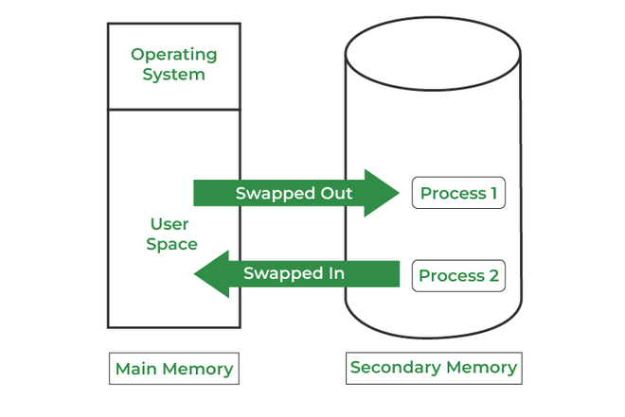
Swapping

Slide 31
CPU Scheduling
In uni-programmming systems like MS-DOS, when a process waits for any I/O operation to be done, the CPU remains idol. This is an overhead since it wastes time and causes the problem of starvation. However, In Multiprogramming systems, the CPU doesn't remain idle during the waiting time of the Process and it starts executing other processes. The operating System has to define which process the CPU will be given.
In Multiprogramming systems, the Operating system schedules the processes on the CPU to have the maximum utilization of it and this procedure is called CPU scheduling. The Operating System uses various scheduling algorithms to schedule the processes.

Slide 32
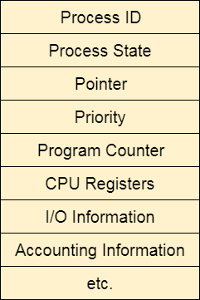
What is saved in the Process Control Block?
The Operating system maintains a process control block during the lifetime of the process. The Process control block is deleted when the process is terminated or killed. There is the following information which is saved in the process control block and is changing with the state of the process.

Slide 33
Why do we need Scheduling?
In Multiprogramming, if the long-term scheduler picks more I/O bound processes then most of the time, the CPU remains idol. The task of the Operating system is to optimize the utilization of resources.
If most of the running processes change their state from running to waiting then there may always be a possibility of deadlock in the system. Hence to reduce this overhead, the OS needs to schedule the jobs to get the optimal utilization of the CPU and to avoid the possibility of deadlock.

Slide 34
Scheduling Algorithms in OS (Operating System)
Here are various algorithms that are used by the Operating System to schedule the processes on the processor efficiently.
The Purpose of a Scheduling Algorithm
Maximum CPU utilization
Fare allocation of CPU
Maximum throughput
Minimum turnaround time
Minimum waiting time
Minimum response time

Slide 35
Scheduling Algorithms in OS (Operating System)
There are the following algorithms that can be used to schedule the jobs.
1. First Come First Serve
It is the simplest algorithm to implement. The process with the minimal arrival time will get the CPU first. The lesser the arrival time, the sooner will the process gets the CPU. It is the non-preemptive type of scheduling.
2. Round Robin
In the Round Robin scheduling algorithm, the OS defines a time quantum (slice). All the processes will get executed in the cyclic way. Each of the process will get the CPU for a small amount of time (called time quantum) and then get back to the ready queue to wait for its next turn. It is a preemptive type of scheduling.

Slide 36
Scheduling Algorithms in OS (Operating System)
3. Shortest Job First
The job with the shortest burst time will get the CPU first. The lesser the burst time, the sooner will the process get the CPU. It is the non-preemptive type of scheduling.
4. Shortest remaining time first
It is the preemptive form of SJF. In this algorithm, the OS schedules the Job according to the remaining time of the execution.

Slide 37
Scheduling Algorithms in OS (Operating System)
5. Priority based scheduling
In this algorithm, the priority will be assigned to each of the processes. The higher the priority, the sooner will the process get the CPU. If the priority of the two processes is same then they will be scheduled according to their arrival time.
6. Highest Response Ratio Next
In this scheduling Algorithm, the process with highest response ratio will be scheduled next. This reduces the starvation in the system.

